Slide 1
NGD - Browse
High Level Design (HLD)
April, 2024

Slide 2
Revisions
Date | Details of Revision | Revised By | Version
04/23/2024 | Original Draft |  | 1.0

Slide 3
Executive Summary
Project Overview
Browse Pages Architecture
Impacted Systems
FED
AEM
Target
SOE
CXP
PEGA NBX
Key Players
SOI
Catalyst
Clarity ID | VZ-00256577
Business Sponsor
RTE
Architects | Srinivasu Rao Pudi
Benefits
Streamline personalization experience
Real Time personalization
Increase revenue/market share
Risks & Dependencies
Title (e.g. Insights & Models)
AI/ML models

Slide 4
Program Overview

Slide 5
Program Overview / Description
Why | Create a effortless browsing experience Create opportunities for various dimensions of personalization.
What | The Personalization Layer is a framework for the rapid deployment of dynamic content across our digital experiences
Who | FED, Digital, SOI, UX/Creative, Product Owners
Where | Browse Pages - Home Page , Plans , Home Internet , BYOD, Gridwall
When | Q2 2024 and ongoing

Slide 6
High Level Requirements & Objectives
High Level Requirements / Rules | Home Page Plans Page Home Internet Page BYOD Gridwall
Objectives | Effortless Browse Streamline personalization experience Real Time personalization Increase revenue/market share
Project Plan Jira Stories | Jira Stories

Slide 7
Risks & Assumptions
Assumptions
Risks / Concerns
Impacts

Slide 8
VCG NSA Implementation - Impacted Components
NSA Components | Impacted
Systems of Engagement
SOE UI | Yes
SOE Experience Services | Yes
AEM | Yes
Customer Experience Platform
Pega CJCM | No
CXP Aggregate Services | Yes
CXP Domain Services | Yes
Systems of Record | No
Systems of Insights | Yes
PEGA NBX | Yes
SOI L1 – VMG | Yes (reporting)
SOI L2 – AI/ML Dev/Models | Yes
SOI L3 – Streaming Engine, SOI Cassandra, AI Processor, etc | Yes (reporting, future)
NSA Components | Impacted
Infrastructure Management
Access Management | No
Logging | Yes
Performance Monitoring | Yes

Slide 9
Logical Architecture

Slide 10
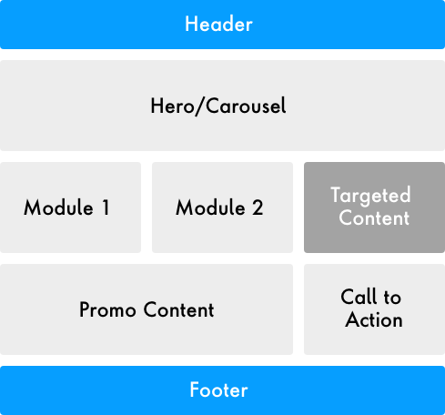
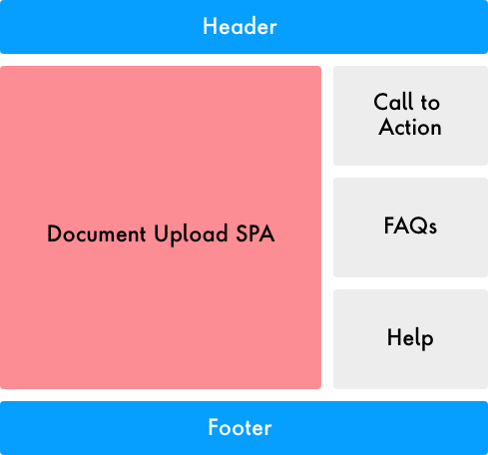
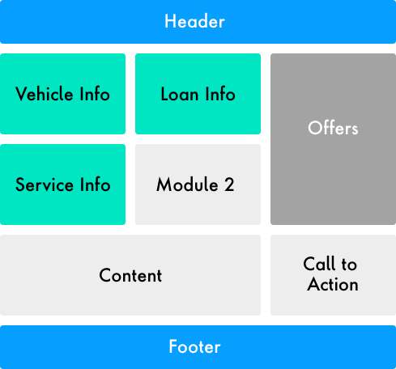
Browse Page Types
Web Framework | Page Patterns
1. Content Driven AEM Pages
2. Dynamic Application Pages
e.g.: Marketing page content managed in AEM and published (Home, Deals , Plans etc)
e.g.: Pages like GW,PDP that can be served from cache but needs to account for personalized dynamic content
e.g.: pages that gets completely dynamic in nature based on customer data
Device Info
Device Detail

Slide 11
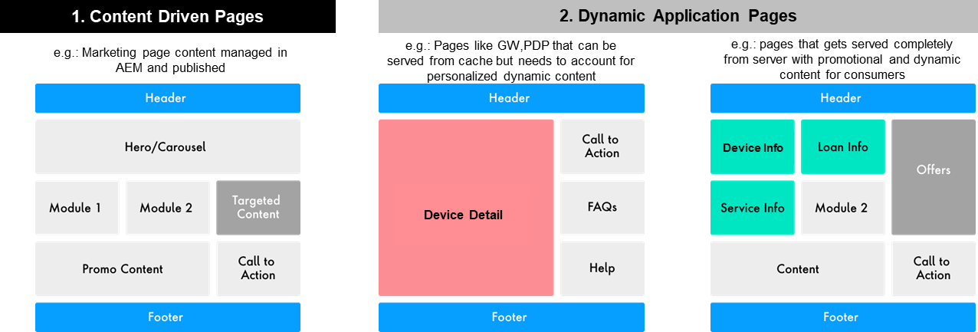
Content Driven AEM Pages

Slide 12













Current State : Content Driven AEM Pages Architecture
Human to
Human
Human to
Machine
Machine to
Machine
+ more
Retail
Center
Chat
Online
Apps
IVR
Social
Chat Bot
Smart Assistant
Car
Home/City
Devices
Partners
UI/UX
UI/UX
Mobile Apps
Static Origin
Images/CSS/JS/Media/HTML /Fonts
Transact CDN (Dynamic Origin)
Landing Pages / JSON
Web Server
WebServer
(AEM Dispatcher)
Security Gateway
Systems of Engagement
API Gateway
Experience Services Layer
Published Content
Content Mgmt (AEM Publisher)
Content Mgmt (AEM Author)
Web Content
Publish
JSON
Content Models
Author Pages Content
JSON Exporter
Systems of Insights
JSON
Publishing Updates
Optional (Performance)
Experience Services
Event Listener
Data Subscriber / Processor / Loader
Cache
Cached Content
Service 1
Service 3
Event Bus
Service 2
...
Retrieve Updated Content
Retrieve Content
CXP (BPM, Journey Tracking, Aggregate/Business Function & Domain Services via API Gateway)
Systems of Record

Slide 13
Home Page

Slide 14

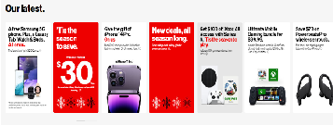
Home Page Current State - Personalization NBX Integration
Design Time
Treat
Control
Prospect User
Feedback Loop
Cradle
If Throttle = Y, fetchOffers
3
Throttle
CXP
1
FED
2
SOE Exp Services (PDM)
4
NBX
Customer
8
6
5
If Throttle = N, emptyResponse
SOI
Prospect
Prospect
content
Default content
Personalized/Generic content
7
AEM
Catalyst
Kafka
Logged-in user visits home page.
FED makes an API call to SOE Exp services.
SOE Exp Svcs makes a call to Cradle to check the throttle.
If throttle = ‘Y, SOE makes a call to NBX to get the personalized response from NBX.
NBX fetches customer profile and insights by making calls to CXP and SOI.
NBX evaluates the propositions based on the customer profile and the insights and returns the response to SOE Exp Svcs.
SOE ExpSvcs fetches the content for the props returned from NBX by making a API request call to AEM.
SOE returns the Offer Response to FED.
If Throttle = ‘N”, SOE sends empty response to FED and FED fetches the AEM content for the default props.
If Prospect user access home page, FED directly makes a call to AEM to fetch the content for Prospect props.

Slide 15
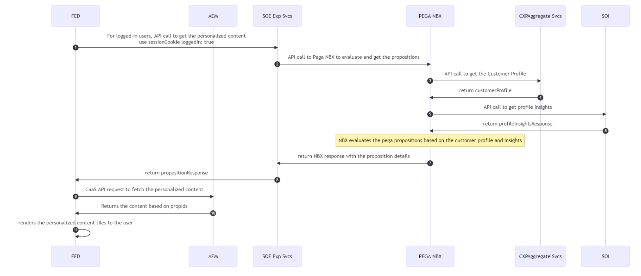
Sequence Diagram

Slide 16
Home Page Current State - Personalization NBX Integration
Design Time
Treat
Control
Prospect User
Feedback Loop
Cradle
If Throttle = Y, fetchOffers
3
Throttle
CXP
1
FED
2
SOE Exp Services (PDM)
4
NBX
Customer
8
6
5
If Throttle = N, emptyResponse
SOI
Prospect
Prospect
content
Default content
Personalized/Generic content
7
AEM
Catalyst
Kafka
Logged-in user visits home page.
FED makes an API call to SOE Exp services.
SOE Exp Svcs makes a call to Cradle to check the throttle.
If throttle = ‘Y, SOE makes a call to NBX to get the personalized response from NBX.
NBX fetches customer profile and insights by making calls to CXP and SOI.
NBX evaluates the propositions based on the customer profile and the insights and returns the response to SOE Exp Svcs.
SOE ExpSvcs fetches the content for the props returned from NBX by making a API request call to AEM.
SOE returns the Offer Response to FED.
If Throttle = ‘N”, SOE sends empty response to FED and FED fetches the AEM content for the default props.
If Prospect user access home page, FED directly makes a call to AEM to fetch the content for Prospect props.

Slide 17
Sequence Diagram

Slide 18
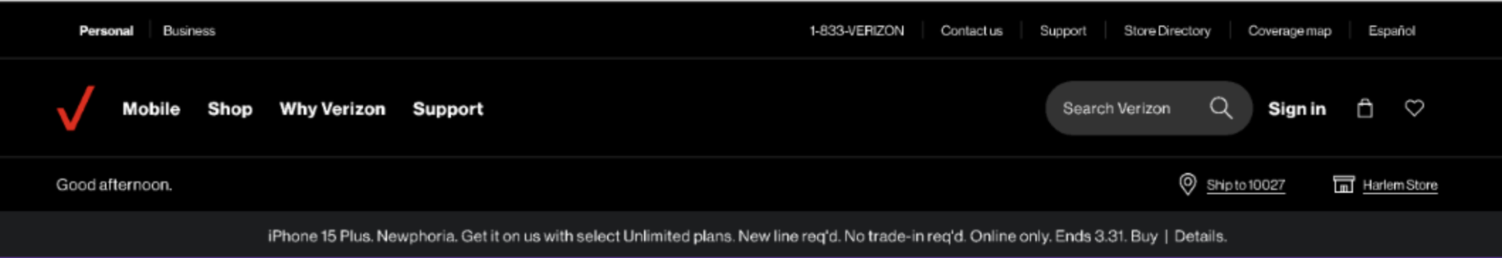
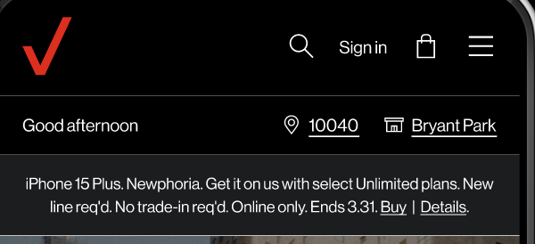
Welcome Greeting Section (Part of Global Nav)
Desktop
Mobile

Slide 19
Welcome Greeting Section (Part of Global Nav) HLD
AEM | New Component - NGD Welcome Greeting. Existing Component - welcome-bar vzdl.utils.newRepeatVisitor = repeat signal would be used to determine the return prospect
Front-End | Planning on using Date function available in JS to detect the time zone of the user. Once timezone is known conditions will be added to display (Good Morning/Good Afternoon/Good Evening message)[configuration of conditions will be done at JS end and customisation will be done at AEM end] If timezone of user is not available, we will display a Welcome/Welcome Back message. For displaying welcome back message, we could use cookies to determine a returning user. Final approach TBD.
Backend | No changes required
Systems Impacted | AEM & AEM-FED Data Layer Tagging Media Tagging AEP
Personalization | Messaging changes based on first-time/return prospect as well as time-based events.

Slide 20

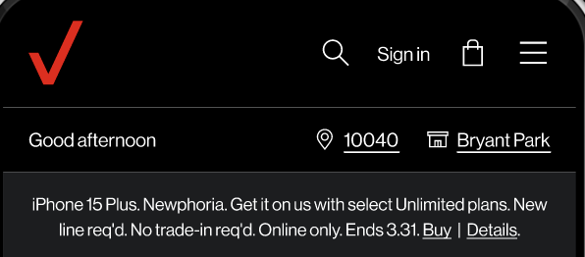
Geo Location Capture Section (Part of Global Nav)
Desktop
Mobile

Slide 21
Geo Location Capture Section (Part of Global Nav) HLD
AEM | New Component - NGDGeolocationCapture (TextField) Existing Component - Grid Label of "Ship to" and text of "use my location" link - Authored
Front-End | Lat Long of the user is determined either using the Browser’s allow location capability OR by using navigator.geolocation Object Once user's latitude and longitude is fetched, an API call will be made to get user's exact location (capturing zip code, city and state) After the location is available, it will be displayed to the user in the header component. User's geolocation will be stored in the local storage of the browser.
Backend | Locus API : This API will provide a type-ahead address suggestion https://api.verizon.com/locus-typeahead/address/typeahead-address?streetterm=norw&countrycode=USA&sortByState=RJ&size=20 (provides address suggestion) With Lat & Long, a call to soe is made to /soe/digital/prospect/qualificationservice/5g/fetchLocusInfo to return location address.
Systems Impacted | AEM & AEM-FED Data Layer Tagging Media Tagging AEP Locus
Personalization | N/A

Slide 22
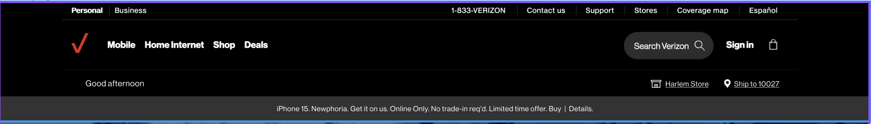
Store Locator Section (Part of Global Nav)
Desktop
Mobile

Slide 23
Store Locator Section (Part of Global Nav) HLD
AEM | This component is populated by FE based on the data in Geolocation capture component.
Front-End | When a new user lands on the website, a pop-up asking for geolocation access permission will display. If user ALLOWS the permission, user's latitude and longitude will be used in order to fetch the nearest store to the user and will be displayed in the store locator component. If user DENIES the access permission, some default value (TBD) will be displayed.
Backend | With Address entered by the User API 1 - search.hereapi.com/v1/autocomplete API 2 -https://geocode.search.hereapi.com/v1/geocode?qq=postalCode=30004&in=countryCode:USA&lang=en-US&limit=20&apikey=8qXu20lZDClhyt8cAqS1GRByBm7897-PsuUdpcuk_iU API 3 - https://www.verizon.com/stores/search-results/?lat=34.12072&long=-84.24309&zip=3000 Geolocated (Use My Location Option) API 1 - stores/ZipByLatLong API 2 - digital/nsa/nos/gw/retail/searchresultsdata
Systems Impacted | AEM & AEM-FED Data Layer Tagging, Media Tagging AEP Locus
Personalization | N/A

Slide 24
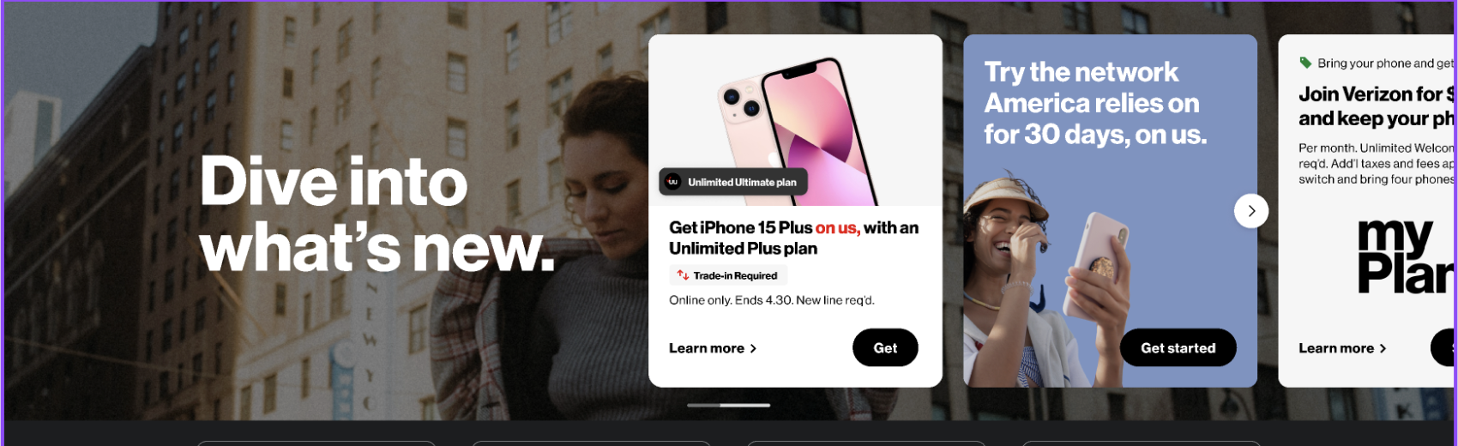
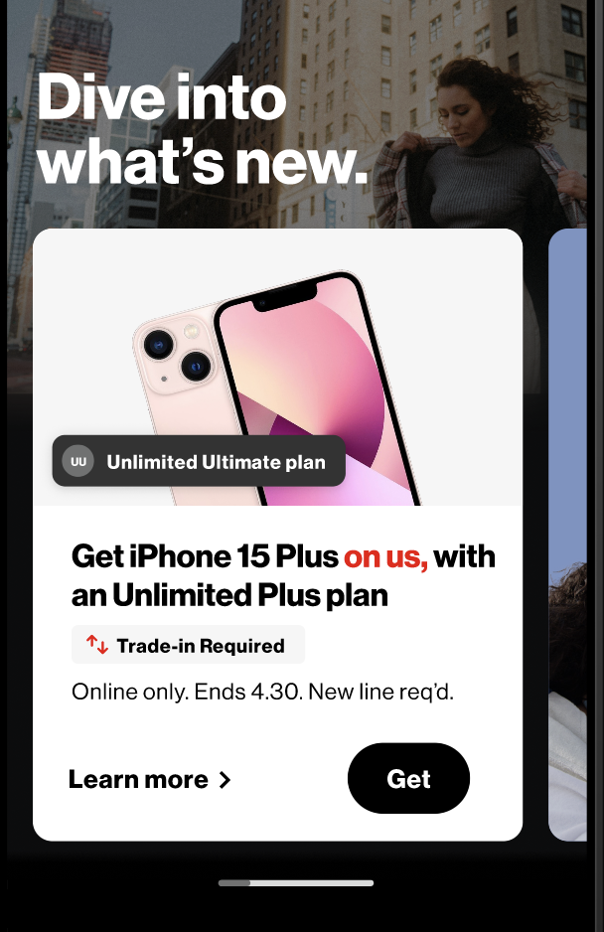
Hero Component Carousel
Desktop
Mobile

Slide 25
Hero Component Carousel
AEM | Existing Components bg image/video - Authored Grid - Authored Column - Authored Text - Authored Core Component Carousel - Authored Content Fragment - Authored Possible New Components NGD Carousel Tiles (Tabbed Component) - Authored
Front-End | Grid AEM Component (which has Video fields) - Grid is used to create the hero section or this Switch to fast reliable Verizon section from current site (lot of places we will use Grid Component) For creating the card placeholder will be provided for title, subtile and image. Actual data inside the cards will come from AEM end and looping (creating multiple) too will be done at AEM end.
Backend | N/A
Systems Impacted | AEM & AEM-FED Data Layer Tagging, Media Tagging AEP, Adobe Target SOI NBX
Personalization | Possibly but TBD.

Slide 26
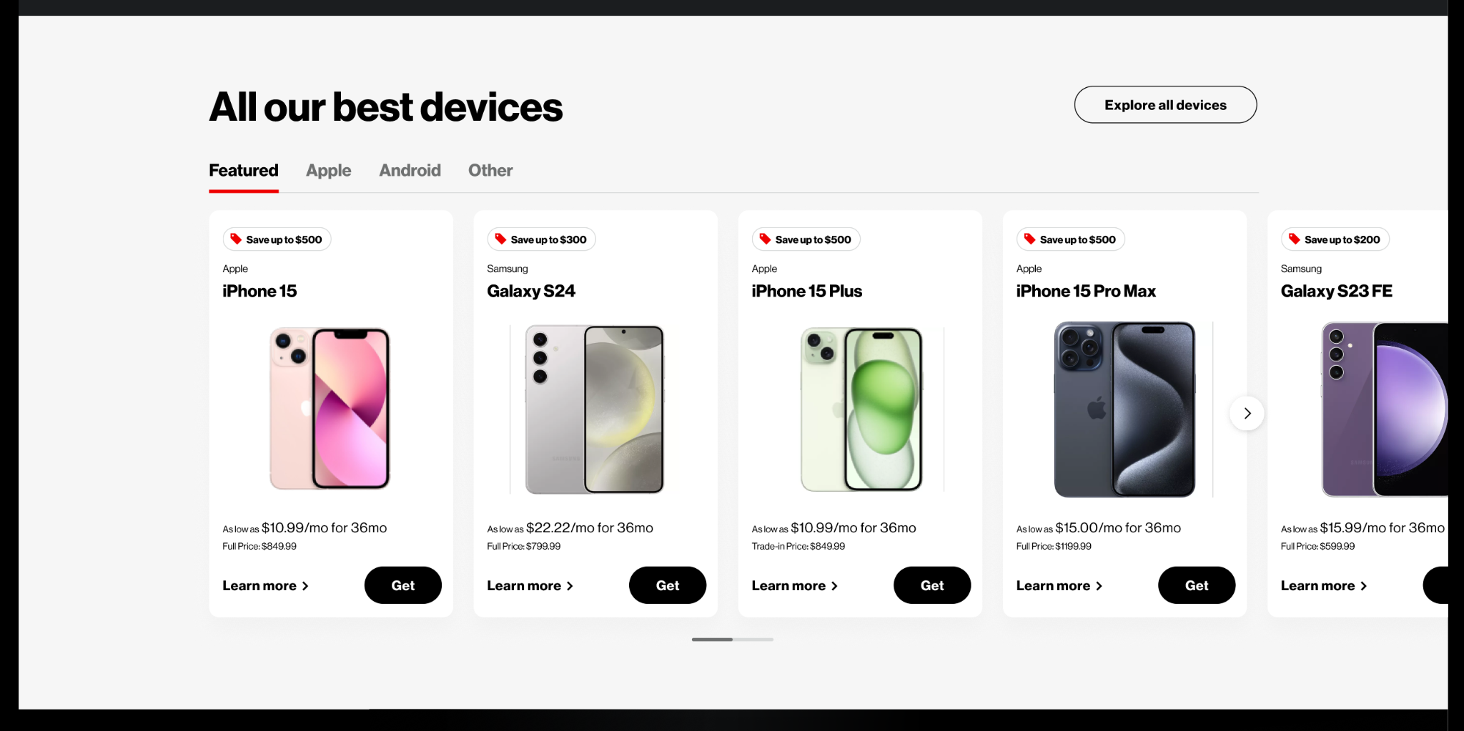
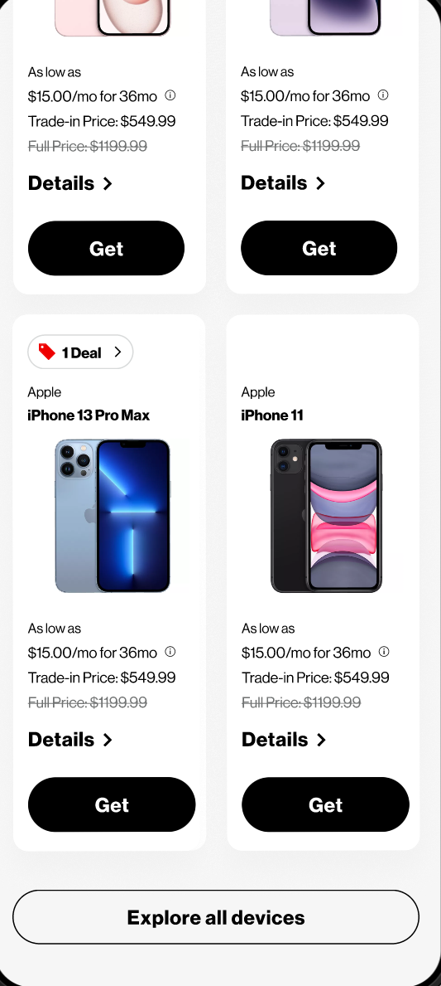
All Our Best Devices Section
Mobile
Desktop

Slide 27
All Our Best Devices Section
AEM | Existing Components - Experience Fragment, Section, Grid, Text, Button New Components - NGD Product Tiles (Copy of existing Product Component) We plan to use the Tab Component, In each tab we are going to add NGD Carousel Component. In NGD Carousel Component dialog, will have multifield of Content Fragment path, we need to select the paths of Content Fragments with the product data. Product data is made available to AEM by calling a SOE API (/getProductList) when the content is published. The carousel component will have a dropdown to select the variation of cards.
Front-End | This will be a personalised component, personalisation approach (contextual or Api based is yet to be decided). Similar cards are present on the existing website, it can be reused partially. Card will be created in FE but the all the text that appears over the card is added from AEM with FE placeholders for it.
Backend | Existing SOE API /getProductList might be used by AEM at the time of publishing.
Systems Impacted | AEM & AEM-FED Data Layer Tagging, Media Tagging and SOE
Personalization | As per the latest discussion, the data on the tiles will be personalised, two approaches are being discussed for this personalisation; Approach 1: Contextualisation - There will be different data sets on the AEM end and based on the signals, appropriate data will be displayed. Approach 2: API Call - An Api call will be made from JS to get the personalised data.

Slide 28
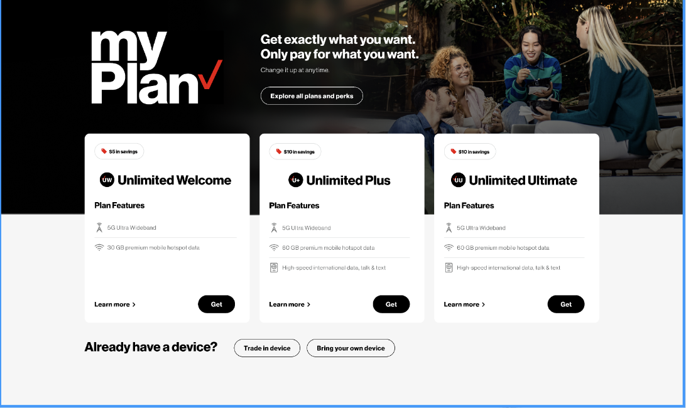
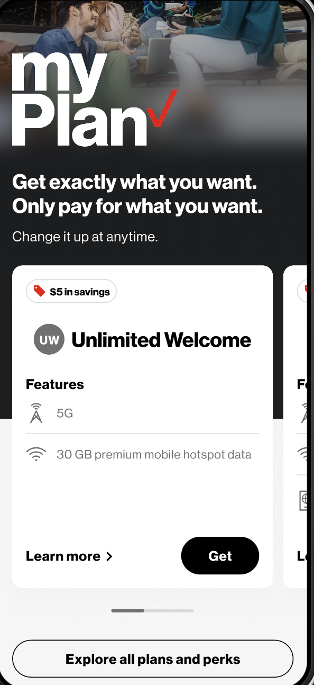
My Plan Section
Desktop
Mobile

Slide 29
My Plan Section
AEM | Existing Components - Section Container, Experience Fragment New Components - NGD My Plan Carousel We will be adding a section component and columns components to create the structure for the section and also provide background Text , Button components will be added For the plan cards, NGD Carousel component will be used, The carousel component dialog will have a multifield to provide content fragment paths
Front-End | This will be a personalized component, personalization approach (contextual or Api based is yet to be decided) Similar cards are present on the existing website, it can be reused partially Card will be created at FE end but the all the text that appears over the card is added from AEM end, FE needs to provide placeholders for it.
Backend | N/A
Systems Impacted | AEM & AEM-FED Data Layer Tagging Media Tagging
Personalization | N/A

Slide 30
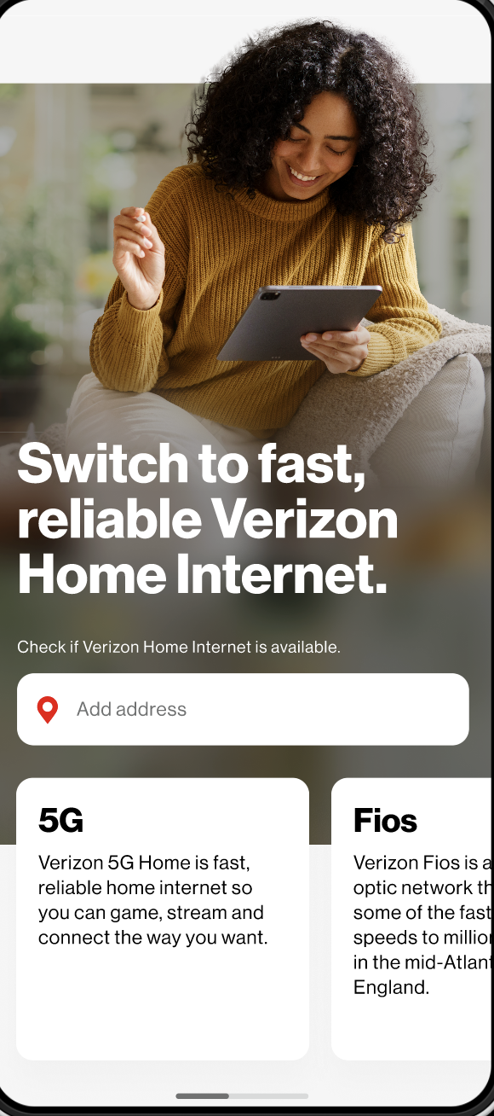
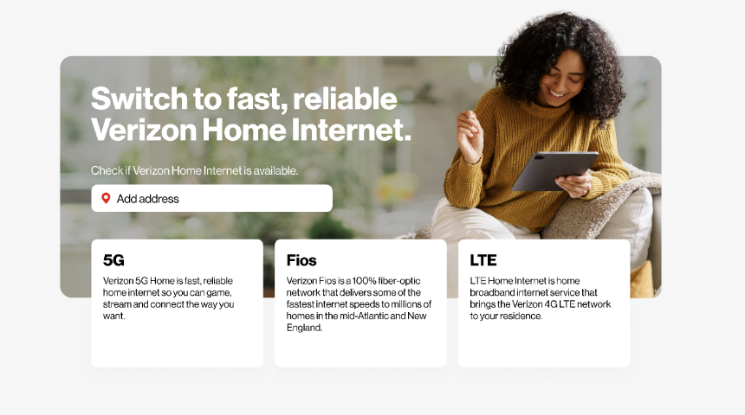
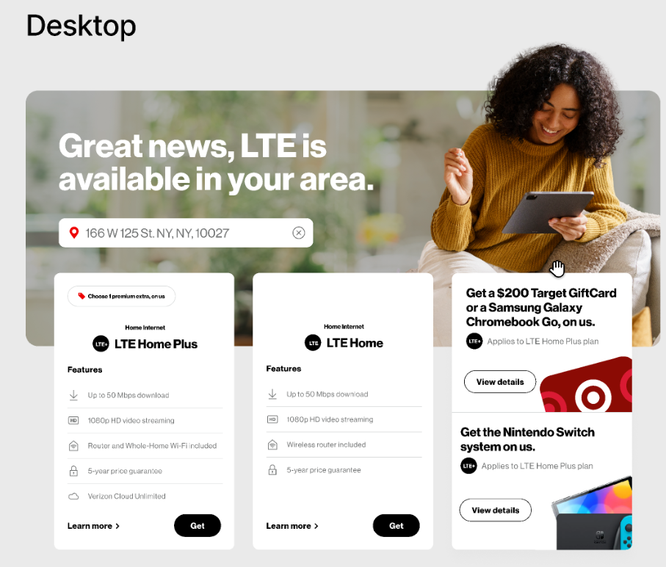
Home Internet Section
Desktop
Mobile

Slide 31
Home Internet Section
AEM | Components Section Container Address Checker Promo Hero NGD Carousel Grid Component Tiles (Internet Plan) Learn More modal would display Plan details as well as offers associated with a given plan. TBD: If 2 different APIs, one to get Plan details and the other to get promotional offers would be made within AEM to get the necessary details.
Front-End | Cards can be partially reused. If user's geolocation is captured in the geolocation component in the header, user's location will be auto populated in the home internet section and user will see the filtered results for home internet services. If user's geolocation is not captured in the geolocation component in the header, user will see a default view of the home internet section, with an empty text box where user can enter their address manually. If user enters in a new address in the text box, it will not be reflected in the geolocation component at the header. When user enters in the address, an API will be called to show the user a list of suggested address. On selection of the address, another api will be called fetching the results of home internet services available in user’s area and based on that appropriate service/plan tiles will show.
Backend | Locus API: https://api.verizon.com/locus-typeahead/address/typeahead-address?streetterm=norw&countrycode=USA&sortByState=RJ&size=20 (provides address suggestion) End-point : https://www.verizon.com/soe/digital/prospect/qualificationservice/nse/check5GAvailability
Systems Impacted | AEM & AEM-FED Data Layer Tagging, Media Tagging SOE, Nautilus, Locus
Personalization | N/A

Slide 32
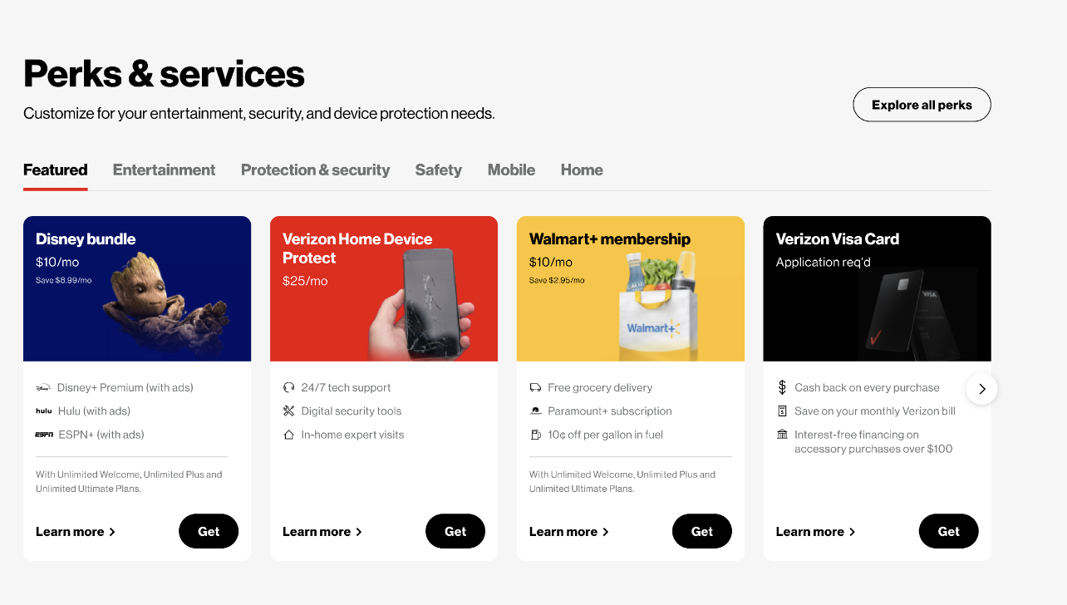
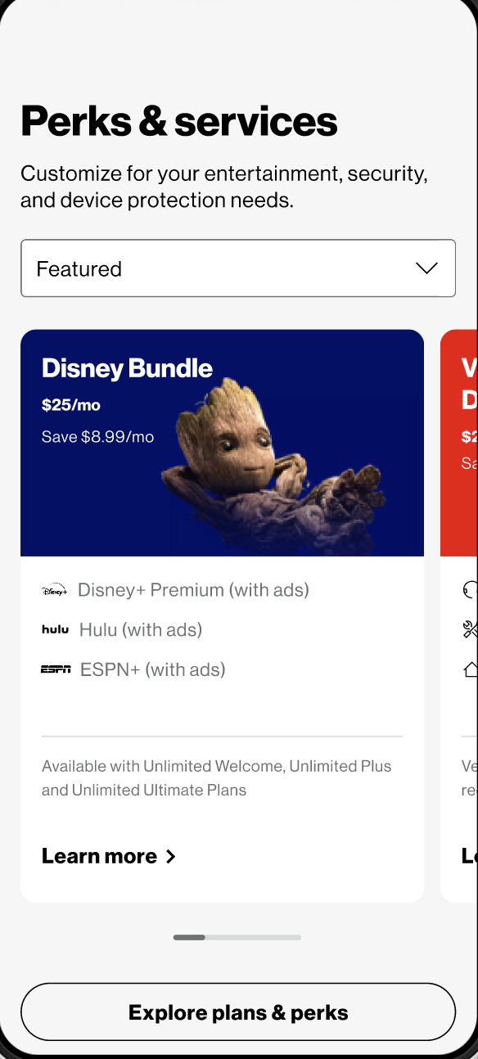
Perks & Services Section
Desktop
Mobile

Slide 33
Perks & Services Section
AEM | Existing Components - Container New Components - NGD perk Carousel, Perk Tile NGD Tabs component will be used to create tab, with in each tab, we are going to add NDG Carousel component. For the NDG Carousel component dialog will have two tabs. Variation : This will be a dropdown with which is used to select the variation of cards to be used in carousel. Here we can name the variation as Perks and Services Variation Content Fragment path list : This will be the path of the content fragment which has the data of the card.
Front-End | Some of the tiles exist and we’ll re-use them.
Backend | N/A
Systems Impacted | AEM & AEM-FED Data Layer Tagging Media Tagging
Personalization | N/A

Slide 34
Personalization

Slide 35
Use Case 1
As a first time visitor to the verizon.com, on a mobile device, given that my current carrier (i.e. T Mobile) is captured as a signal, I want to see a ‘switch to verizon’ deal displayed in one of the content tiles on the homepage hero component.
Signals Used | Current Carrier
Systems Used | AEP - Captures the signal and sends to Target and SOI. Target - Has logic to check for the mobile carrier (or ISP) and serves up an appropriate personalized content.
Mechanism Used | AEP returns user current carrier. Based on this carrier Target returns personalized content.

Slide 36
Use Case 2
As a returning visitor to the verizon.com, on desktop, who has previously viewed the iPhone deals page (/deals/iphone), I want to see content for iPhone deals in the tiles on the homepage hero component and the Discover Mobile section of the homepage.
Signals Used | Device Browsing History
Systems Used | AEP - Collect browsing history (based on Device / Deals / Mobile Plan /Internet Plan / Accessory) for prospect user Target - Returns personalized content based on browsing history (Device / Deals / Mobile Plan / Internet Plan / Accessory) of user during a fixed requested time period. SOI - Provides insights/recommendations based on the returned browsing history.
Mechanism Used | NEW API to Target/SOI exposed through SOE. Fields passed in the Request ecid/username/userid/email Device Time period for which history is requested. Sample Response Pages browsed Brands Devices & Accessories Deals Plans

Slide 37
Use Case 3
As a returning visitor to verizon.com, who has previously visited the ‘Bring your own device’ page (/bring-your-own-device/) multiple times, I want to see content related to BYOD in one of the tiles on the homepage hero component.
Signals Used | Browse history (verizon), Link clicks frequency
Systems Used | AEP - Capture browsing history (& no of times page visited) for prospect user Target - Returns browsing history of user related to BYOD during a fixed requested time period. SOI - Provides insights/recommendations and offers for BYOD.
Mechanism Used | NEW API to Target/SOI exposed through SOE. Fields passed in the Request ecid/username/userid/email Device you’re bringing and device(s) you’re interested in Time period for which history is requested. Sample Response BYOD specific deals and offers List of Devices eligible for BYOD No. of visits to BYOD

Slide 38
Use Case 4
As a returning visitor to verizon.com, who has previously added an iPhone 15 Pro device and Unlimited Ultimate plan to my cart but abandoned it, I want to see content in one of the homepage hero tiles prompting me to return to configuring my plan with a CTA that takes me back to the cart configurator with that device and plan combination selected.
Signals Used | Browse history (verizon), Existence of Cart
Systems Used | AEP - Capture abandoned cart info for prospect user Target - Returns browsing history of user along with the abandoned cart ID. SOI - Provides insights/recommendations and offers for BYOD.
Mechanism Used | NEW API to Target/SOI exposed through SOE. Fields passed in the Request ecid/username/userid/email Time period for which history is requested. Sample Response Abandoned Cart details if one exist for the user. Relevant recommendations pertaining to the abandoned cart Appropriate offers to push the user to convert the abandoned cart.

Slide 39
Dynamic Application Pages Architecture (Non-AEM)

Slide 40
Next.js Rendering Patterns for Application Pages (Non AEM)
Next.js | Rendering Strategy | Application Pages
Dynamic application pages can be rendered leveraging various rendering patterns to drive efficiencies and page performance.
Server Rendering
Server + Client Rendering
Client Rendering
Header
Title | Interactive Component
Image
Content
Content
Content
Footer
Header
Title | Interactive Component
Image
User Specific Content
Content
Slow fetch Content
Footer
Header
Title | Interactive Component
Image
User Specific Content
Content
Client side rendered
Footer
Header
Title | Interactive Component
Image
User Specific Content
Content
Content
Footer
Pattern 1
For Static Pages which can be generated at build and Cached
Pattern 2
For Non-Cacheable Personalized / Dynamic Page
Pattern 3
For Cacheable Pages with Personalized / Dynamic Page
Pattern 4
Server Component – Static Rendering
Client Component
CSR Client Side Rendering
Server Component – Dynamic Rendering
Server Component – Streaming
Base Template

Slide 41
Pattern 1 : For Static Pages which can be generated at build and Cached [Server Rendering]
Rendering Strategy | Application Pages | Pattern 1
Header
Title | Interactive Component
Image
Content
Content
Content
Footer
CDN
VZ Yellow Zone
VZ Green Zone
Request Page
Cache HIT
No
OpenIG/Apigee
Node.js
GNAV Fetch
AEM
Browser
Data Fetch
Yes
SOE
Render
Set Cache
Return response
HTML + RSC Payload
Return response
Use Case: Ideal for static pages (non-aem) like T&C without personalized content
Rendering:
All components are Server components. For non-interactive components, React rendering occurs on server.
Caching: Full page HTML + RSC Payload cached at CDN + Data fetching can be cached in memory
Advantages:
HTML + Payload can be generated at build time, or on-demand later.
Should improve performance for slower devices and connections
Notes:
1. Response is used to immediately show a fast non-interactive page
3.The React Server Components Payload is used to reconcile the Client and Server Component trees, and update the DOM.
4.The JavaScript instructions are used to hydrate Client Components and make the application interactive

Slide 42
Pattern 2: For Non-Cacheable Personalized / Dynamic Page [Server Rendering]
Rendering Strategy | Application Pages | Pattern 2
Header
 | Interactive Component
User Specific Content
Content
Slow fetch Content
Footer
Yellow Zone
Green Zone
Request Page
OpenIG/Apigee
Node.js
GNAV Fetch
AEM
Browser
Data Fetch
SOE
NBX
Render
Return response
HTML + RSC Payload
Use Case: Ideal lower funnel and Service pages with personalized content. Suitable for GW + PDP traffic when deployed to Edg.io.
Rendering:
The server will make personalized requests and render components on-demand. All components are Server components.
For non-interactive components, React rendering occurs on server.
For slow fetch content Server response can be streamed and rendered on the client as it becomes available.
Caching: CDN cache not available for personalized requests. Data fetching can be cached in memory. (Next.js cache can be In memory or shared cache like Redis)
Advantages:
Rendering at the on the server, at the Edge, can generate high performance personalized responses.
Should improve performance for slower devices and connections

Slide 43
Pattern 3 : For Cacheable Pages with Personalized / Dynamic Page [Server + Client Rendering]
Rendering Strategy | Application Pages | Pattern 3
Header
Title | Interactive Component
Image
User Specific Content
Content
Client side rendered
Footer
CDN
Yellow Zone
Green Zone
Cache HIT
GNAV Fetch
Request Page
No
OpenIG/Apigee
Node.js
AEM
Data Fetch
Yes
SOE
Browser
Render
Return response
Return response
Set Cache
HTML + RSC Payload
Client-Side Fetch
OpenIG/Apigee
NBX
Use Case: Can be used for pages with personalized content. Places the obligation to fetch and render personalized content on the client.
Rendering:
The client will make personalized requests and render components in the browser. Some components are Server components. For non-interactive components, React rendering occurs on server.
Caching: CDN available for server components. Server data fetching can be cached in memory. Personalized fetch cached in browser. (Next.js cache can be In memory or shared like Redis)
Advantages:
Can reduce the burden/traffic on the server by not rendering personalized components on server side.
Don’t need to scale infrastructure more as pages are cached on CDN

